Slide 1
Higher National Diploma (HND)
Digital Technologies
Unit 20: Internet of Things
Identifying, describing and solving problems using IoT

Slide 2

Recap
Last Week’s Topics
Identified and discussed real-world problems solvable with IoT solutions
Examined how IoT technologies can address these problems
Select and justifying architecture, tools, hardware, software, and APIs for solving the problems
Reviewed problem-solving requirements
Planning strategies for IoT solutions
What are the problem-solving requirements for the smart bin in your assignment scenario?

Slide 3
Formative Recap
Last week, we made a plan for our IoT application according to a standard framework.
This week, we’ll focus on the “problem” element of planning a prototype IoT application
What was difficult about defining the “problem” for the previous assignment?
What was easy?

Slide 4
SESSION AIM AND OUTCOMES
By the end of this class, students will be able to:
Evaluate steps for identifying and describing IoT-applicable problems
Apply understanding to create a detailed IoT problem description for the assignment scenario

Slide 5
Quiz - Week 5: Identifying, describing and solving problems using IoT
Click here to take this short quiz to assess your existing understanding of today’s lesson.

Slide 6
Identifying and describing problems when developing an IoT solution
When developing an IoT solution, its is vital to:
Identify, understand, and articulate the problem at hand
Know what the IoT solution is intended to accomplish
Understand the context where the solution will operate
To leverage IoT effectively in offering solutions, you must:
clearly identify and describe the problems the IoT solution aims to address
ensure clarity to align the solution with real-world issues
develop solutions that effectively tackle the identified problems.
(IndustryWeek, n.d).

Slide 7
Why is identifying and describing a problem important?
Enables efficient allocation of resources
Reinforce why an IoT solution is important to the stakeholders.
Illustrate expected value to be realised from the IoT solution
Ensures that the right solutions are implemented
Helps in prioritising of the problems
Ensures that the right problems are being addressed
Avoids wastage of resources and time
(IndustryWeek, n.d).

Slide 8
How to identify and describe the problem?
The following steps are applicable when identifying and describing the problems to be solved with an IoT system:
Understand the industry or domain where IoT will be applied
Evaluate the current processes and systems in place
Identify the pain points of stakeholders, which may also be described as their needs and requirements.
Determine the feasibility of the potential IoT solutions
(McEwen and Cassimally, 2013; Maciej, 2016).
Now, let us look at each step in subsequent slides.

Slide 9
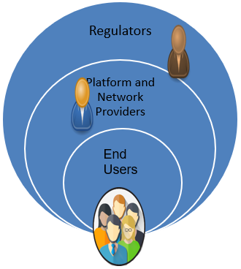
Understanding the domain
Knowing the domain helps define the scope, users, and requirements of the solution.
To understand the domain, you need to identify the following:
      End Users: Purchase and operate solutions
      Platform and Network Providers: Provide platform and network services etc
      Regulators: Provide certifications, ensure standardization, quality and security.
(McEwen and Cassimally, 2013; Maciej, 2016).

Slide 10




Class activity
Identify the Internet of Things (IoT) domain and application relevant to the assignment scenario
Consider the end users, regulators, and the platform and network services involved
Pair up with another student and share your ideas

Slide 11

Evaluate the current process and system
Identify if an existing process or system is in place
Provide a detailed description of it
Analyse existing systems to pinpoint their weaknesses and clients need
Recognise cases where no existing system is available for evaluation.
This process is crucial for accurately defining the IoT problem
(McEwen and Cassimally, 2013; Maciej, 2016).

Slide 12
Steps to help evaluate the existing system
Assess its aims and objectives
Examine components involved in its operation (use physical and logical diagrams)
Evaluate whether it is functioning effectively and meeting users’ requirements
Identify the its weaknesses that render it no longer fit for purpose
Assess the current hardware, software, network connectivity, and data management components to clarify why it is inadequate
(McEwen and Cassimally, 2013; Maciej, 2016).

Slide 13
Class Activity
Assess and provide a description of the current systems addressing the problem in the assignment scenario
Pair up with another student and share your ideas

Slide 14

Identify the pain points of stakeholders
Mainly related to client needs and requirements
How do you identify the pain points of stakeholders:
Conduct interviews or surveys
Analyse the data
Evaluate user experience
Review industry trends
Engage with stakeholders
(McEwen and Cassimally, 2013; Maciej, 2016).

Slide 15
Class Activity
What are the needs and requirements of the client in the assignment scenario?
Pair up with another student and share your ideas

Slide 16

Evaluate whether your proposed solution is convenient.
Key factors to consider:
Flexibility: Can adapt to evolving technology?
Scalability: Can expand or contract with needs?.
Agility: Supports exploring and implementing new applications.
Robustness: Reliable data storage and management systems
(Maciej, 2016; Sunitha 2021).
Determine the feasibility of
potential IoT solutions

Slide 17
Technical feasibility: Assessing if the IoT solution is technically feasible to implement, given the current state of technology.
Key factors to consider:
Compatibility: Devices and technologies work together
Scalability: Can handle growing data volumes
Security: Adequate measures to protect data
Reliability: Consistent data collection and transmission
Interoperability: Seamless integration with other systems
(Maciej, 2016).
Other important factors to consider when assessing feasibility

Slide 18
Economic feasibility: Assess if the IoT solution is financially viable.
Key factors to consider:
Cost: Evaluate investment, maintenance, and operational expenses
RoI: Assess short- and long-term return on investment?
Revenue: Potential to generate income or efficiency gains?
(Maciej, 2016).
Other important factors to consider when assessing feasibility

Slide 19
Operational & Legal feasibility: Assessing if the IoT solution is feasible within the existing operational and legal framework.
Key factors to consider:
User acceptance: Ease of use; minimal training required?
Regulatory compliance: Meets laws and data privacy requirements
Organisational impact: Effects on structure, processes, and culture
Liability: Responsibility for harm or damages
Intellectual property: Address patents and trademarks
(Maciej, 2016).
Other important factors to consider when assessing feasibility

Slide 20
Class Activity
How feasible is your proposed solution?
Pair up with another student and share your ideas

Slide 21
Summary
In this session, we covered the following topics:
Steps that ae applicable when identifying and describing problems that IoT can solve
Identify and describe an example of an IoT problem relating to the assignment scenario
We concluded that clearly identifying and understanding the problem is a key step in creating IoT solutions that address real-world needs

Slide 22
REFERENCES
Arshdeep, B. (2014) Internet of Things: A Hands-on Approach. 1st Ed. VPT.
Fernández-Caramés, T.M. and Fraga-Lamas, P. (2020). Teaching and Learning IoT Cybersecurity and Vulnerability Assessment with Shodan through Practical Use Cases. Sensors, [online] 20(11), pp.3048–3048. doi:https://doi.org/10.3390/s20113048.
IndustryWeek, n.d. How to achieve success with the IoT. [online]. Available at: https://www.plm.automation.siemens.com/media/global/pt/How%20to%20Achieve%20Success%20with%20IoT_tcm70-84668.pdf [Accessed 1 May 2023].
Maciej, K., 2016. Building the Internet of Things: Implement New Business Models, Disrupt Competitors, Transform Your Industry. Wiley
McEwen, A. and Cassimally, H., 2013. Designing the Internet of Things. 1st Ed. John Wiley and Sons..
Sunitha (2021). Feasibility of IoT applications. [online] Thingsofiot.com. Available at: https://www.thingsofiot.com/blog/feasibility-of-iot-applications [Accessed 1 May 2023].
Wei, L., Liu, S., Wu, J., Long, C., Ma, S. and Li, B., 2019. Enabling distributed and trusted IoT systems with blockchain technology. IEEE Blockchain Technical Briefs.

Slide 23

QUESTIONS

Slide 24
Higher National Diploma (HND)
Digital Technologies
Unit 20: Internet of Things
Week 5, Session 2: Choosing the appropriate set of tools and techniques for developing an IoT solution

Slide 25
Recap
In the previous session, we covered:
Steps to identify and describe problems suitable for IoT solutions
How to create a detailed IoT problem description
How to assess the feasibility of potential IoT solutions
Can someone remind us why it is important to identify and describe a problem when you are creating an IoT solution?

Slide 26
Session Aim and Outcomes
By the end of this class, students will be able to:
Evaluate the importance of selecting appropriate tools and techniques for developing an IoT solution.
Analyse the steps to select suitable tools and techniques for IoT development.
Assess factors influencing the choice of IoT components when designing a solution to a real-world problem

Slide 27
Choosing Appropriate Tools and Techniques For Developing An IoT Application
After identifying and describing the problem, the next step is to propose a solution.
This requires selecting appropriate tools and techniques
Appropriate selection means choosing tools and techniques that:
    align with the desired functionalities and stakeholders' requirements
    address environment constraints
    fit within the budget
(IoT For All, 2024; Molex, 2024).

Slide 28
Why is it Important to Select the Right Set of Tools and Techniques?
Ensure the solution meets the problem's requirements efficiently
Ensure the solution aligns with stakeholder expectations
Ensure project is scalable and sustainable ​
Create a reliable and cost-effective IoT solution
Improve security
Ensures seamless compatibility among the different components
(IoT Analytics, 2018)

Slide 29
Steps to Ensure the Selection of Appropriate Tools and Techniques
Step 1. Decide on the appropriate IoT architecture
Choose a structure that best supports the project’s requirements, scalability, and data flow.
This will help you to lay a blueprint for the IoT application within an ecosystem in advance.
Step 2. Select appropriate IoT devices
Choose sensors, actuators, and other hardware that meet performance, environmental, and cost requirements.
This will ensure that your IoT contains devices that can collect data and communicate with other networked devices.
Step 3. Choose an appropriate gateway and network connection
Choose a gateway and network connectivity that is suitable for your IoT application.
Cellular, Wi-Fi, Bluetooth, LPWAN.
You may have to consider the IoT problem requirements during the process.
(Domínguez-Bolaño, 2022)

Slide 30
Steps to Ensure the Selection of Appropriate Tools and Techniques Continued
Step 4. Choose the appropriate IoT platform
Choose a platform that supports device management, analytics, and integration with other systems.
This will ensure you can effectively control and centralise every aspect of the IoT network and its connected devices.
Step 5. Use appropriate cloud services
Choose one that will support fast collection and delivery of processed data to a user device and provide organised, centralised storage.
Step 6. Put appropriate security measures in Place:
Briefly analyse the various security measures that can be put in place to guard against hacking and data breaches for your IoT application.
You can implement encryption, authentication, and other security protocols to protect data and devices
(Domínguez-Bolaño, 2022)

Slide 31


Class Activity
Based on what you have learned, discuss and decide on:
The most appropriate system architecture for your smart bin
The best network connection for transmitting data from the bins to the council’s monitoring system
The platform you would use
Notes:
T: form groups as appropriate to the classroom dynamic

Slide 32
Factors to consider in choosing appropriate IoT architecture
Scalability
Security
Interoperability
Cost
User Experience
Reliability
(Sultanow, and Chircu, 2018).

Slide 33
Factors to consider in choosing appropriate IoT architecture
Cost
Power consumption
Processing power
Scalability
Interoperability
Availability of support and documentation
(Sultanow, and Chircu, 2018).

Slide 34
Factors to consider in choosing appropriate IoT platform
Scalability
Security
Data Analytics and Insights
Cost and Pricing Model
Customisation and Flexibility
Regulatory Compliance
(Sultanow, and Chircu, 2018)

Slide 35
Factors to consider in choosing appropriate IoT software
Compatibility and Interoperability
Scalability
Security and compliance requirements
Cost
Customisation and Flexibility
Usability
(Sultanow, and Chircu, 2018).

Slide 36
Factors to consider in choosing appropriate IoT frameworks
Project size and complexity
Budget and resources
Security and compliance requirements
Ease of development and integration
Vendor support and ecosystem
Interoperability
(Sultanow, and Chircu, 2018).

Slide 37
Factors to consider in choosing appropriate IoT APIs
Data Size & Data Frequency
Network constraints
Security
Integration
Scalability
Compliance
(Sultanow, and Chircu, 2018).

Slide 38
Class Activity 2
Discuss the key factors to consider when selecting appropriate network and communication technologies, as well as cloud services, for developing an IoT solution.
Post your findings in the class discussion forum on Moodle
Notes:
T: form groups appropriate to the classroom dynamic

Slide 39
SUMMARY
In this session, we covered the following topics:
Choosing the appropriate set of tools and techniques for developing an iot solution
Factors that can influence the choice of appropriate IoT components when developing an IoT application to solve a problem
We concluded that choosing the appropriate tools and techniques is an important phase in developing an IoT application that solves real-world issues.

Slide 40
REFERENCES
Arshdeep, B. , 2014. Internet of Things: A Hands-on Approach. 1st Ed. VPT.
Domínguez-Bolaño, T., 2022. An overview of IoT architectures, technologies, and existing platforms. Science Progress, 105(3), pp.1–20. Available at: https://www.sciencedirect.com/science/article/pii/S254266052200107X [Accessed 23 October 2024].
IoT Analytics, 2018. IoT Platform Selection: 3 Best Practices You Should Adopt. [online] Available at: https://iot-analytics.com/iot-platform-selection-3-best-practices/ [Accessed 23 October 2025].
IoT For All, 2024. Key Components of an IoT Platform and How to Choose One. [online] Available at: https://www.iotforall.com/iot-platforms-key-components-and-how-to-choose-one [Accessed 23 January 2025].
Molex, 2024. 3 Considerations for Designing IoT Devices of the Future. [online] Available at: https://www.molex.com/en-us/blog/3-considerations-for-designing-iot-devices-of-the-future [Accessed 23 January 2025].
Sultanow, E. and Chircu, A.M., 2018. A review of IoT technologies, standards, tools, frameworks, and platforms. Proceedings of the 2018 IEEE International Conference on Internet of Things (iThings), pp.1–8. Available at: https://ieeexplore.ieee.org/document/8396794 [Accessed 23 October 2024].

Slide 41
QUESTIONS

Slide 42
Higher National Diploma (HND)
Digital Technologies
Unit 20: Internet of things
Week 5, Session 3: A case study of an IoT domain (Smart home)

Slide 43
Recap
Last Session:
We discussed how to choose the appropriate set of tools and techniques for developing an IoT solution.
We explored factors that influence the selection of IoT components, ensuring solutions meet requirements, are scalable, secure, and cost-effective.
Can someone remind us of the steps to ensure the selection of appropriate tools and techniques?

Slide 44
Session aim and outcomes
By the end of this class, students will be able to:
Evaluate smart home as a case study for IoT solutions, demonstrating an understanding of its applications, as well as the relevant tools and technologies involved.
Identify and analyse real-world problems within the smart home domain to determine how IoT can be applied to develop effective and innovative solutions

Slide 45
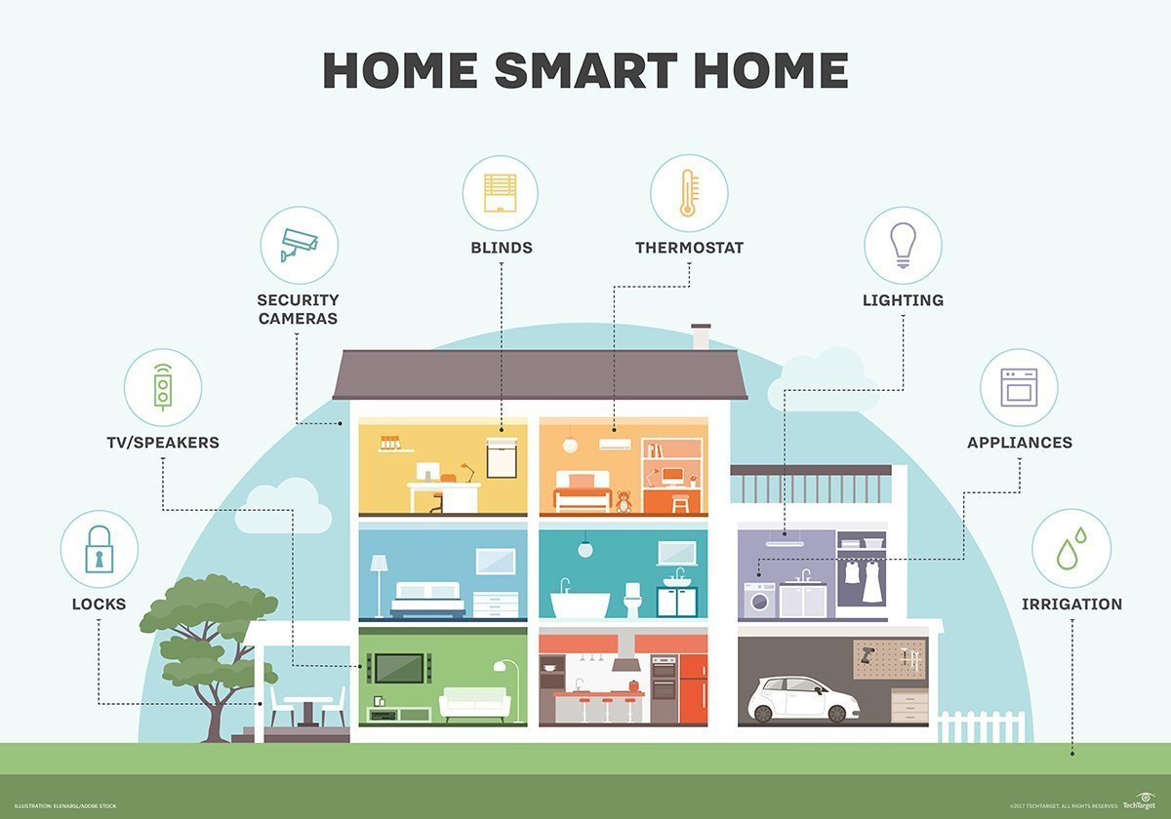
Case study: understanding the smart home domain
The first smart home began in 1975, with the X10, which utilised a home’s existing power line wires for communication
Definition: Any home that can be remotely managed via a smart phone, PC or other electronic device
Sensors are used to capture data from the physical domain
(Yasar, and Shea, 2023).

Slide 46

A demonstration of a smart home system

Slide 47
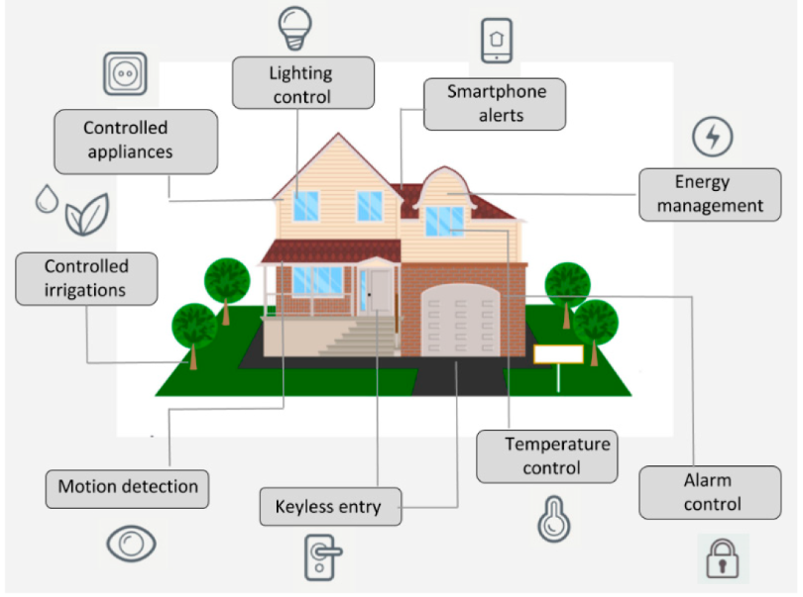
IoT application in smart homes
Smart Lighting
A design of a lighting automation system:
Control the lights in a typical home remotely using a web application
The system include auto and manual modes
Auto mode: Measures room light level and turns on the light when it gets dark.
Manual mode: Provides the option of manually and remotely switching on/off the light.
(Bahga and Madisetti, 2015)

Slide 48
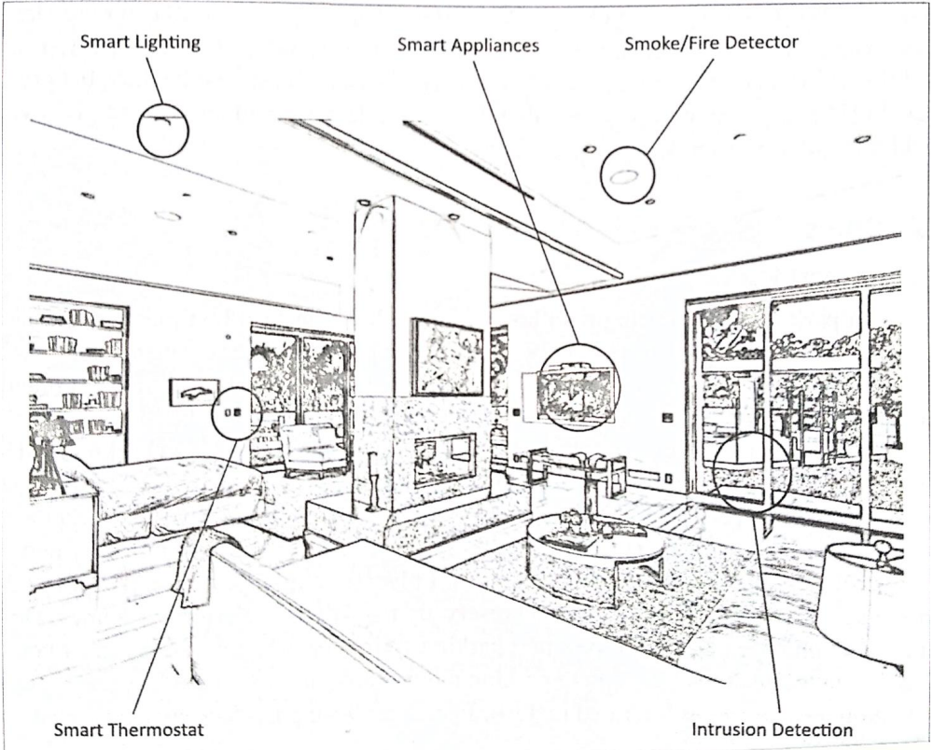
Class Activity
Please write down and describe what you think are other potential IoT application areas for smart homes seen in the picture?

Slide 49
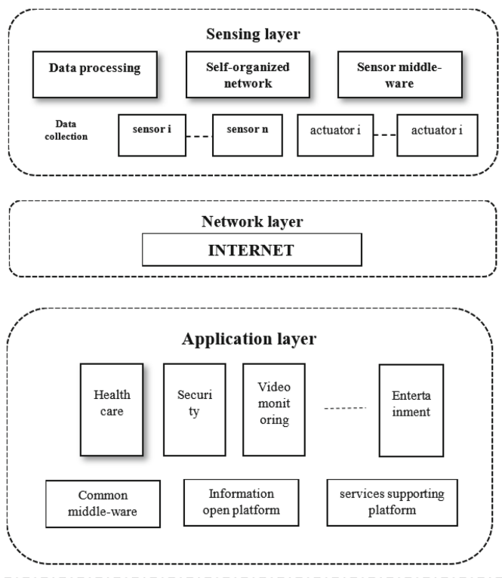
A Three Layer Smart Homes Architecture
The architecture on the left-hand side can be divided into three layers:
1. Sensing layer
2. Network layer,
3. Application layers
Functionality: Smart appliances are connected to the internet and can be remotely controlled via a management platform
(Bing et al., 2011)

Slide 50
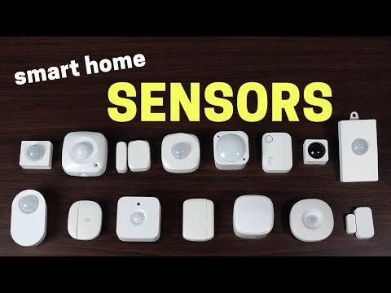
IoT HARDWARE FOR SMART HOME
Here are some of the IoT hardware devices used in smart homes:
Sensor
Actuators
Microcontroller
Communication modules
Smart devices
Please watch the video on the right for demonstrations of sensors
(Yasar and Shea, 2023; Intuz, 2023).

Slide 51
IoT SOFTWARE FOR SMART HOMES
      Here are two examples of open-source software for smart home:
Home Assistant Controller Hub
Central control system for smart home devices
Controls lighting, climate, entertainment systems, and home appliances
OpenHAB (Open Home Automation Bus)
Open-source home automation software.
Actions triggered by rules, voice commands, or the openHAB user interface
(Home Assistant, 2023; openHAB Foundation e.V, 2023).

Slide 52
IoT Platforms for Smart Homes
      Here are two examples of platforms for smart home:
Samsung SmartThings
  Platform for connecting and controlling smart devices in a home
  Allows homeowners to monitor and control their home from a single app on their phone
Control4
  Provides automation and networking systems for homes and businesses.
  Offers a unified smart home system to automate and control connected devices
      (Samsung Electronics, 2023; Control4 Corporation, 2023).
Notes:
Both Samsung SmartThings and Control4 are compatible with a wide range of third-party devices, which allows users to expand their smart home ecosystem beyond Samsung and Control4-branded products.

Slide 53
IoT Cloud Services for Smart Homes
      Here are two examples of cloud service providers for smart homes
AWS IoT
Provides cloud-based services for IoT applications
Supports billions of devices securely connecting to AWS endpoints
Ensures reliable and secure device communication
Azure IoT
A suite of services for building and managing IoT applications
Enables device connection, monitoring, and control
Provides bi-directional communication between devices and solution back-end
(Amazon Web Services, 2023; Microsoft, 2023).

Slide 54


Class Activity 2
Research common Smart Home solutions that might be used in your local area
What cloud providers do they use? Which infrastructure? What ecosystem?
Discuss 3-4 advantages and challenges to Smart Home solutions
Discuss appropriate IoT components you would use to build your solution to the problems
Prompt a large language model to feed back some answers to the above. Post your findings in the GenAI playground forum on Moodle.
Notes:
T: form groups appropriate to the classroom dynamic

Slide 55
Summary​
In today's lesson, we have :
Looked at smart home and its various applications
Outline some of smart homes IoT components available in the industry
Identify and describe a problem within the smart home domain

Slide 56

Week 5 Formative Activity
Identify and clearly describe the problem in your assignment scenario.
Structure the problem according to the following points:
  IoT domain/application
  Current processes and systems in place
  Pain points of stakeholders, that is, their needs and requirements
  Feasibility of the potential IoT solutions
  Determine the appropriate set of tools and techniques to include in an application to solve the problem
(approx. 45 mins)
(LO2: P4, M3).

Slide 57
Remember…
Please ensure that you include a description of the problem and select the most suitable IoT architecture, frameworks, tools, hardware, and API techniques for your application in your PowerPoint slides for the presentation(P4, M3).
For guidance on citing references in your work according to Pearson’s Harvard style, please use Cite Them Right in the library.

Slide 58
REFERENCES
Amazon Web Services., 2023. AWS IoT Core. [online] Available at: https://aws.amazon.com/iot-core/ [Accessed 23 October 2025].
Bing, K., Fu, L., Zhuo, Y. and Yanlei, L., 2011. Design of an internet of things-based smart home system. In: 2011 2nd International Conference on Intelligent Control and Information Processing, Harbin, [online], pp. 921–924 (2011). https://doi.org/10.1109/ICICIP.2011.6008384
Control4 Corporation., 2023. Control4 Smart Home Solutions. [online] Available at: https://www.control4.com/ [Accessed 23 October 2024].
Domb, M., 2019. Smart home systems based on internet of things. [Online]. Available at https://doi.org/10.5772/ intechopen.84894 (24th April 2023)
Home Assistant., 2023. Home Assistant. [online] Available at: https://www.home-assistant.io/ [Accessed 23 October 2024].
Intuz, 2023. Building-smart-home-devices-with-matter-and-wireless-technologies [Online]. Available at https://www.intuz.com/building-smart-home-devices-with-matter-and-wireless-technologies (24th April 2023)
IoT Analytics. ,2015. The 10 most popular Internet of Things applications right now. [online] Available at: https://iot-analytics.com/10-internet-of-things-applications/ [Accessed 24 Apr. 2023].
Microsoft., 2023. Azure IoT. [online] Available at: https://azure.microsoft.com/en-us/overview/iot/ [Accessed 23 October 2024].
Minteer, S.D., Gu, W., Chen, W., He, Y., Wu, Y. and Zhang, Y. (2018). Smart Home: Architecture, Technologies and Systems. Procedia Computer Science, [online] 131, pp.393–400. doi:https://doi.org/10.1016/j.procs.2018.04.219.

Slide 59
REFERENCES Continued
openHAB Foundation e.V. , 2023. openHAB. [online] Available at: https://www.openhab.org/ [Accessed 23 October 2024].
Samsung Electronics., 2023. SmartThings. [online] Available at: https://www.smartthings.com/ [Accessed 23 October 2024].
Smart Home Tour 2023: Fully Automated!, 2023. YouTube video, added by Smart Home Solver [Online]. Available at Smart Home Tour 2023: Fully Automated! 👀 (youtube.com)(24th April 2023)
What is a Smart Home or Smart Building?, 2023. YouTube video, added by Eye on Tech [Online]. Available at What is a Smart Home or Smart Building? – YouTube (24th April 2023)
Wu, C.L., Liao, C.F. and Fu, L.C., 2007. Service-oriented smart-home architecture based on OSGi and mobile-agent technology. IEEE Transactions on Systems, Man, and Cybernetics, Part C (Applications and Reviews), 37(2), pp.193-205.
Yasar, K. and Shea, S., 2023. smart home [online]. Available at What is a Smart Home? Everything You Need to Know|Definition from TechTarget[Accessed 1 May 2023].

Slide 60
QUESTIONS

